Slide 1

Federal Financial Aid Updates
Reconciliation Bill (H.R. 1)
One Big Beautiful Bill Act
And Other Updates/Reminders
OASFAA Conference
January 2026

Slide 2
Agenda
Background
OBBB
Federal Guidance
2026-27 changes
Institutional Accountability
Program Integrity & Institutional Quality
Distance Education & R2T4
FAFSA
TIV Programs
Pell Grant, Federal Work-Study, Direct Loans
Outstanding Questions

Slide 3
Background
Federal Register Notice Final Rules
Program Integrity and Institutional Quality
Federal Guidance – Electronic Announcements & Dear Colleague Letters
One Big Beautiful Bill Act (OBBBA)
Passed in July 2025
Aka Reconciliation Bill or H.R. 1
Dozens of changes coming to Federal Financial Aid
Most become effective for the 2026-27 academic year
Impacts all schools
We will cover some of the major changes, but not all
Some changes still need to go through the Negotiated Rulemaking Process

Slide 4
Institutional Accountability
July 1, 2026
Creates new accountability measure that would cause a program to lose Direct Loan eligibility if more than half of the programs fail the “low earnings outcomes” measure 2 out of 3 years
UG – compares median earnings of completers in academic programs to earnings of “working adults” with HS Diploma or GED
GR – compares median earnings of completers in academic programs to earnings of “working adults” with a bachelor’s degree
Some published proxy benchmarks exist, but they aren’t exactly apples to apples

Slide 5
Program Integrity and Institutional Quality
Federal Register Notice Final Rule (January 3, 2025)
Effective July 1, 2026
GE/FVT
Distance Education
Return of Title IV (R2T4)

Slide 6
Gainful Employment and Financial Value Transparency
New Do-No-Harm Framework
Establishes uniform penalty for all programs
Uses a single metric instead of debt-to-earnings metric
Consistent Penalty – loss of eligibility of Direct Loan Program for 2 years after failing earnings premium in 2 of 3 consecutive years
To all programs at all institutions
Financial Value Transparency now called Student Tuition and Transparency System (STATS)

Slide 7
Distance Education
Definition change, effective July 1, 2026, 34 CFR 600.2
Added the definition of a course offered exclusively through distance education
DE course one in which instruction takes place exclusively through the technologies defined under distance education in the regulations
Not withstanding any in-person non-instructional requirements (orientation, testing, academic support services)
A hybrid course that requires some in-person instruction (no matter how short) is not a DE course under the new regulation
Enrollment reporting 34 CFR 668.41(h), effective July 1, 2027
Schools will be required to report whether TIV recipients are enrolled in hybrid courses or 100% distance education or 100% in-person course work

Slide 8
Return of Title IV (R2T4)
Effective July 1, 2026, early implementation February 3, 2025 (optional)
New Withdrawal Exemption (if all 4 met then no R2T4 calc required)
For payment period or period of enrollment
Student is a no-show for period (did not start attendance)
Return all TIV grants and loans to ED (including credit balances)
School refunds all institutional charges
School cancels (writes-off) any balance owed to school due to returning TIV funds to ED
Applies to all educational program types (including modules)
Optional exemption, case-by-case, document
34 CFR 668.22

Slide 9
Return of Title IV (R2T4)
Effective July 1, 2026, early implementation February 3, 2025 (optional)
Leave of Absence (LOA) and Incarcerated Students PEP
Enrolled in a Prison Education Program
Confined or incarcerated students on approved LOA may return to any point in program
Applies to term-based and all other educational program types
Schools are not required to grant an LOA

Slide 10
Return of Title IV (R2T4)
Effective July 1, 2026
Date of Determination (not necessarily new, but is no in the reg)
An institution required to take attendance must, within 14 (calendar) days of student’s last date of attendance, assess whether the student has withdrawn
Scheduled Clock Hours
Must use “payment period” method to determine scheduled clock hours in period
No longer use the cumulative scheduled hours from beginning of the program up to the WD date/LDA (so all students are treated consistently)
Modules
Include module as part of the payment period in denominator only when student begins attendance in module
Eliminates optional R2T4 freeze date (fixed calendar point)

Slide 11
FAFSA Changes
Real-time identity verification for studentaid.gov account creation when use SSN (no longer a 1-3 day waiting period)
When student starts the FAFSA first
Only need to enter an email address to invite a contributor
Does not have to be same email contributor used for FSAID
Student notified when invitation sent to contributor
Student notified when contributor accepts invitation
Contributor given an Invitation Code
Enter Invitation Code, then able to complete their section of the FAFSA

Slide 12
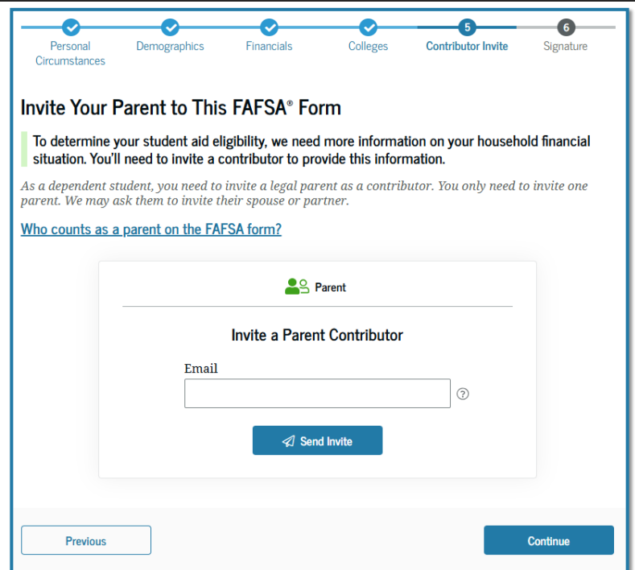
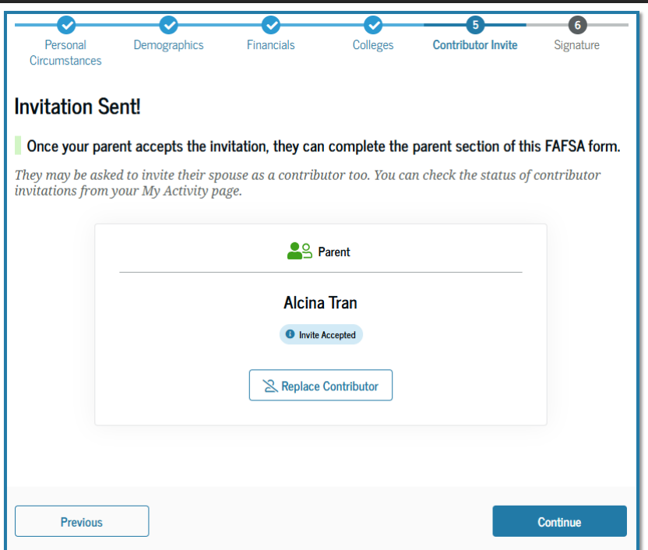

Slide 13
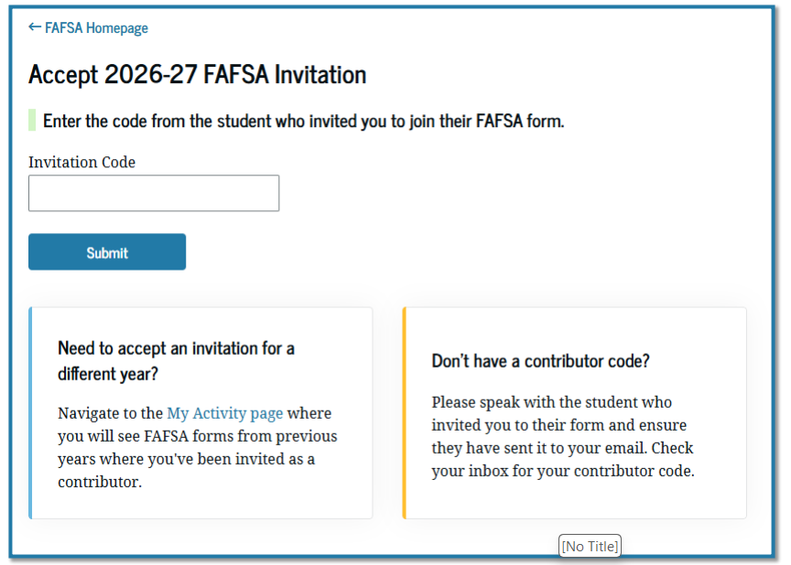

Slide 14
2026-27 FAFSA Changes
Reinstates asset exemptions (was removed in 2024-25)
Family-owned small business (100 or fewer employees-full time equivalent)
Family farm (family resides on the farm)
NEW: Family-owned commercial fisheries (owned & controlled by the family)
Requires foreign income be included in AGI to calculate Pell eligibility
Ends requirement that a financial aid administrator must individually determine if adding the exempted foreign income to the AGI would make the student ineligible to receive the maximum Pell Grant
Contributors must manually report foreign earned income
Foreign Income will automatically be added to AGI for SAI calculation

Slide 15
Title IV Aid Program Specific Changes
Pell Grant
Federal Work-Study (FWS)
Direct Loans Aggregate Limits
Parent PLUS Loan (PLUS) for parent of dependent undergraduate students
Graduate PLUS for Graduate and Professional students
Interim Exceptions
Repayment Programs

Slide 16
Federal Pell Grant
Students with High SAI
Current need analysis ignores assets if income below a certain threshold
Student may qualify for a ‘minimum Pell Grant” even with $1 million in assets
NEW:
2026-27 award year, no longer eligible for Pell Grant if SAI equal to or greater than twice the maximum Pell Grant award (14,790)
No change to IASG Pell (dependents of deceased service members/public service officers)
Full COA with Grants and Scholarships
Grants and scholarships from non-federal sources that exceed Cost of Attendance (COA)
Ineligible to receive Pell Grant, even if otherwise eligible

Slide 17
Workforce Pell Grant
Effective July 1, 2026
Creates Workforce Pell Grant Program
School must be Title IV eligible
Pell Grant for qualified short-term programs
Eligible programs must be:
Between 8 and 14 weeks in length
Between 150 and 599 clock hours

Slide 18
Workforce Pell Grant
ED and the States will determine other eligibility requirements
Program must be aligned with in-demand jobs which meet employer needs and must be approved by the governor
Program must have been offered by the institution for at least one year
Program must have a 70% or higher completion rate and a 70% or higher job placement rate within 180 days
Program Cost cannot exceed the value-added earnings
Credit must be allowed to transfer into future degree programs

Slide 19
Federal Work-Study
REMINDERS:
Schools do have an obligation to distribute voter registration forms (see your PPA)
Criteria for voting under federal, state, and municipal law
Distribute voter registration information in physical or electronic communication

Slide 20
Federal Work-Study
DCL GEN-25-05 Policy Guidance on use of FWS funds as required by the HEA
Cannot use FWS funds for jobs in political activities (partisan and non-partisan)
Voter Registration
Voter Assistance
Poll Worker
Voter Registration Forms
Remind students of federal, state, and municipal law for voting
Distribute voter registration information in physical form or electronic communication
May limit distribution to students eligible to vote in federal and state elections
Rescinded effective August 19, 2025: DCL GEN-22-05 and GEN-24-03
34CFR 675.22(b)(5) & 34 CVR 668.14(d)

Slide 21
Undergraduate Federal Loan Programs
Federal UG student annual loan limits remain unchanged
Current undergraduate limits
Annual
Dependent FR $5,500, SO $6,500, JR/SR $7,500 in Subsidized/Unsubsidized Loan
Independent FR $10,500, SO $11,500, JR/SR $12,500 in Subsidized/Unsubsidized Loan
Aggregate
Dependent $31,000 Subsidized/Unsubsidized combined (max of $23,000 sub)
Independent $57,500 Subsidized/Unsubsidized combined (max of $23,000 sub)

Slide 22
Parent PLUS Loan for Undergraduate Dependent Student
Currently & prior to July 1, 2026
To qualify, parent must not have Adverse Credit (not as strict as a typical consumer loan)
Student must be enrolled at least half-time in a degree-seeking or eligible certificate program
Limited by Cost of Attendance minus Other Aid = Max PLUS
Example: COA $20,000 - $11,000 other aid = $9,000 max PLUS annual

Slide 23
Parent PLUS Loan for Undergraduate Dependent Student
Beginning July 1, 2026
NEW:
New Parent PLUS Loan annual and aggregate limits
$20,000 per dependent student per year
$65,000 lifetime aggregate limit for each student
Once reach limit, cannot borrow more even if previous loans are repaid, forgiven, cancelled, or discharged
Interim exception (legacy provisions) for current Parent PLUS Loan borrowers
Dependent student is enrolled June 30, 2026 AND
Either the student has previously borrowed a Direct Loan for that program of study
OR a parent has previously borrowed a PLUS Loan for that student as of June 30, 2026
May continue borrowing PLUS for 3 academic years or the remainder of their expected time in program, whichever is LESS
Students who change majors within the same degree or certificate WILL be considered to be enrolled in same program of study

Slide 24
Graduate PLUS Loan for Graduate and Professional Students
Currently & prior to July 1, 2026
Student must not have Adverse Credit (not as strict as a typical consumer loan)
Student must be enrolled at least half-time in a degree-seeking or eligible certificate program
Currently Graduate PLUS Loans have no annual or lifetime aggregate limit
Limited by Cost of Attendance
Example: COA $20,000 - $11,000 other aid = $9,000 max PLUS annual

Slide 25
Graduate PLUS Loan for Graduate and Professional Students
Beginning July 1, 2026 (Instruction beginning on/after July 1, 2026)
NEW: Graduate PLUS Loan Program eliminated for new borrowers
Interim exception (legacy provision) for current Graduate students
Must be enrolled in studies June 30, 2026
Must have already received any kind of Direct Loan for the current program of study
May continue borrowing from the program for 3 academic years or the remainder of their expected time in the program, whichever is less
If withdraw/cease attendance, no longer eligible under current limits
Approved LOA could continue borrowing under legacy provisions

Slide 26
Graduate and Professional Student Annual and Aggregate Direct Loan Limits
Current annual loan limits for Graduate and Professional students
Graduate Student $20,500 in Unsubsidized Loan
Professional Student $50,000 in Unsubsidized Loan
Current aggregate loan limits for Graduate and Professional students
Graduate Student $138,500 all Subsidized/Unsubsidized including UG
Professional Student $200,000 all Subsidized/Unsubsidized including UG

Slide 27
Direct Loan Limits Annual and Aggregate
NEW: Graduate aggregate limit reductions
$100,000 Graduate who has not been a Professional student
$200,000 Professional student who has not been a Graduate student
$200,000 Been both a Graduate Student and a Professional student
Interim exception (legacy provision) for current Graduate students
Must be enrolled in studies June 30, 2026
Must have already received any kind of Direct Loan for the current program of study
May continue borrowing from the program for 3 academic years or the remainder of their expected time in the program, whichever is less
https://www.nasfaa.org/uploads/documents/2026-27_Beyond_Graduate_Professional.pdf

Slide 28
Definition of Professional Student
Completion academic requirements to begin practice
Level of professional skill beyond normally required for bachelor’s
Doctoral Level, requires at least 6 academic years of study
At least 2 years of post-baccalaureate level
Requires professional licensure to begin practice
ED Secretary determines four-digit program CIP codes eligible

Slide 29
Direct Loan Limits Annual and Aggregate
Beginning July 1, 2026
NEW: Lifetime Maximum Loan Limit for students $257,500
Does not include the amount borrowed by Parent for Parent PLUS or the Graduate PLUS Loan amount
Maximum limit does not change even if funds are repaid, forgiven, cancelled or otherwise discharged
Interim exception (legacy provision) for current students
Must be enrolled in studies June 30, 2026
Must have already received any kind of Direct Loan for the current program of study
May continue borrowing from the program for 3 academic years or the remainder of their expected time in the program, whichever is less

Slide 30
Direct Loan Annual Limit Proration
2026-27 award year
NEW:
Student loans must be prorated in direct proportion to the percentage of full-time status the student is enrolled
Annual loan limits will be reduced in direct proportion to a student’s enrollment
Was effective upon enactment July 4, 2025
ED is currently developing the schedule of reductions (as required by the law)
Not currently enforceable
Schools WILL be required to use the schedule of reductions for 2026-27 and later

Slide 31
Federal Loan Repayment Options
Borrowers with new loans made on or after July 1, 2026
Tiered Standard Repayment Plan Modified
Replaced the standard 10 year repayment plan
Repayment term on a sliding scale based on outstanding principal balance
Income-Based Repayment Assistance Plan (RAP)
On-time payments under RAP count for PSLF
Immediately get credit for PSLF under RAP
If do not make a selection, automatically enrolled in RAP

Slide 32
Federal Loan Repayment Options
Current borrowers with no new loans made on or after July 1, 2026
Eligible to enroll in current Standard, Graduated, Extended or current Income Based (IBR) repayment plans
Revised criteria for IBR
No longer requires partial financial hardship
PLUS borrowers who consolidated can now enter IBR (previously only ICR)
May switch between, enter or remain on existing IDR plans until July 1, 2028
Current borrowers with a new loan on/after July 1, 2026 may also choose one of the 2 new repayment plans

Slide 33
Loan Deferment Options
Borrowers with loans made before July 1, 2027 are still able to use economic hardship and unemployment deferments
Once all borrower’s loans made prior to that date are paid in full, these options cease to exist
Loans made on or after July 1, 2027
Not eligible for unemployment or economic hardship deferments

Slide 34
Loan Forbearance
Current rules allow for forbearance up to 12 months at a time with a cumulate limit of 3 years
New: Loans made on or after July 1, 2027 are eligible for forbearance for up to 9 months in any 2-year period

Slide 35
Default Loan Rehabilitation Terms
Currently borrowers can rehabilitate a defaulted loan once
NEW: Borrowers can rehabilitate a defaulted loan twice
$10 minimum payment during rehabilitation period

Slide 36
Outstanding Questions
We don’t have all the answers yet
Will implementation be delayed by Congress?
The Negotiated Rule Making Process will provide guidance
Funding gaps
Where will families and students turn?
How will private lenders respond to market changes (if at all)?

Slide 37
Outstanding Questions
New challenges for Financial Aid Offices
Shifting volume between loan types
Reduced loan options for summer sessions, 4th yr & beyond, Grad students
More questions from students and families about options to pay for school
Required loan proration for less than full-time enrollment
Particularly challenging for Graduate students
Many summer students enrolled less than full-time
Updating materials and website with changes
Communicating in advance
Configure systems to treat interim exception borrowers differently than new borrowers
Communicating with families and students
….and more

Slide 38
Questions?

Slide 39
Reference Materials
https://www.congress.gov/bill/119th-congress/house-bill/1/text
https://www.nasfaa.org/uploads/documents/Federal_Student_Aid_Change_OB3.pdf
https://fsapartners.ed.gov/knowledge-center/library/electronic-announcements/2025-08-15/2026-27-fafsa-form-and-pell-grant-eligibility-updates
NASFAA Chart: Federal Student Aid Changes from OBBBA

Slide 40
Reference Materials
Executive Order 14168
EA APP-25-05
DCL GEN-25-04
EA APP-25-23
DCL GEN-25-05

Slide 41
Contact Information
Kathy Campbell
Lane Community College
campbellk@lanecc.edu
Karen Ash
Linn Benton Community College
ashk@linnbenton.edu

